Slide 1
Questions
that make a difference
Keeping What Matters
in Our Mind
Dr. Marshall Goldsmith
Marshall@MarshallGoldsmith.com
www.MarshallGoldsmith.com

Slide 2
Goals
Learn classic delusions that prohibit us from creating the person that we want to become.
Be ready to use the daily question process to increase effectiveness and build engagement.

Slide 3
What matters in life
Health
Wealth
Relationships
Happiness
Meaning (Achievement)

Slide 4
Why do so few ‘New Year’s resolutions’ get implemented?
Only 8% of our good plans get implemented
We consistently underestimate the challenges presented by the environment
We have very little discretionary time
The high probability of at least one ‘low probability event’ occurring

Slide 5
New world – new challenges
“The dream”
Globalization
New technology
New entertainment
New distractions
Media addiction

Slide 6
We know the person that we want to create. Why don’t we do it?
Ten Classic Delusions
It won’t take that long (time)
It won’t be that hard (difficulty)
I can keep focused on this goal (competing goals - distractions)
Once I do it, it will take care of itself forever (maintenance)
Once I do it, my whole life will change (over-estimating rewards)

Slide 7
More delusions
‘Today is different’ (uniqueness)
The ‘me’ that is doing the planning is the same ‘me’ that is doing the executing (planner bias)
I will be supported in my change efforts by my environment (attribution error)
If I change, my efforts will be recognized by others (fairness)
I have great willpower and don’t need help (ego)

Slide 8
Keeping what matters in our mind
The ‘daily question’ process
Why it works
Why we need it
The Checklist Manifesto
Using ‘active’ questions

Slide 9
The Ford ‘weekly review’
Top 5 priorities
Red, yellow, green
Feedforward
Why most leaders won’t do this

Slide 10
Active questions vs. passive questions
How active questions focus on what you can do to make a positive difference for yourself and the world
How passive questions focus on what the world needs to do to make a positive difference for you

Slide 11
Three groups –
‘before and after’ measures
Training and follow-up – active questions
Training and follow-up – passive questions
Training and no follow-up
No training (control)
Initial study results – ACTIVE questions make a difference!

Slide 12
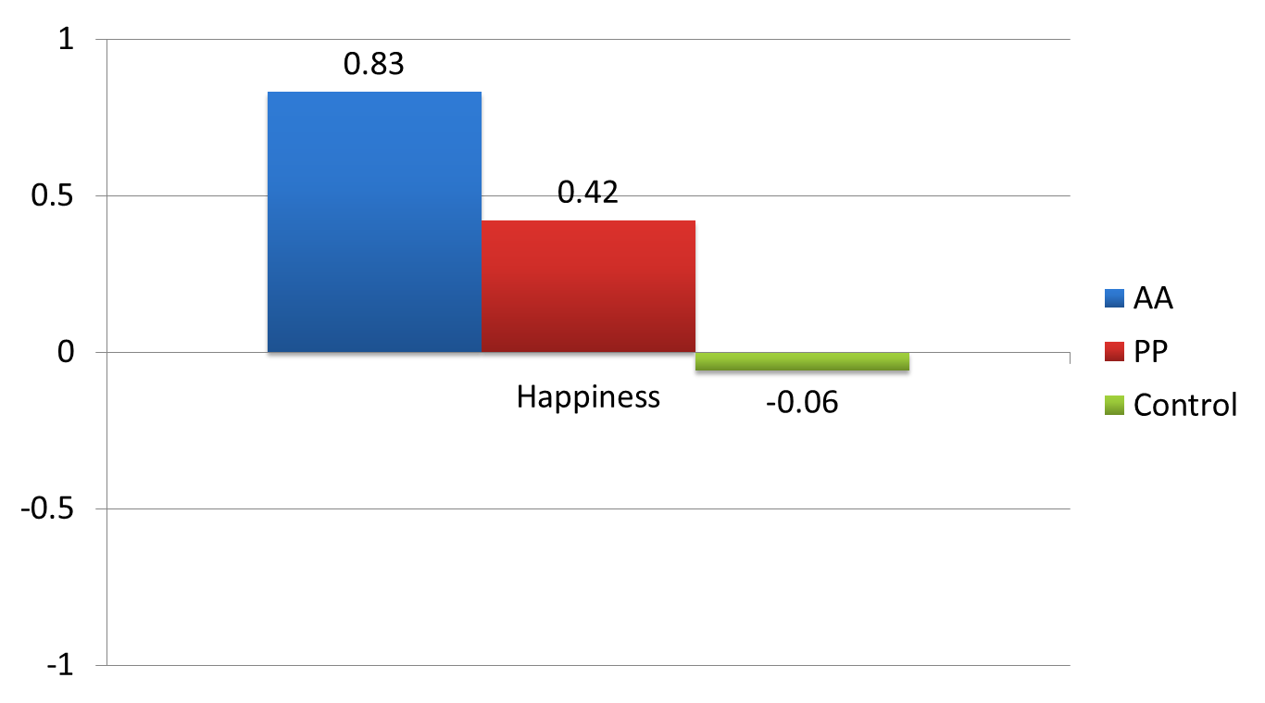
Happiness Means by Condition on a -3 to +3 scale

Slide 13
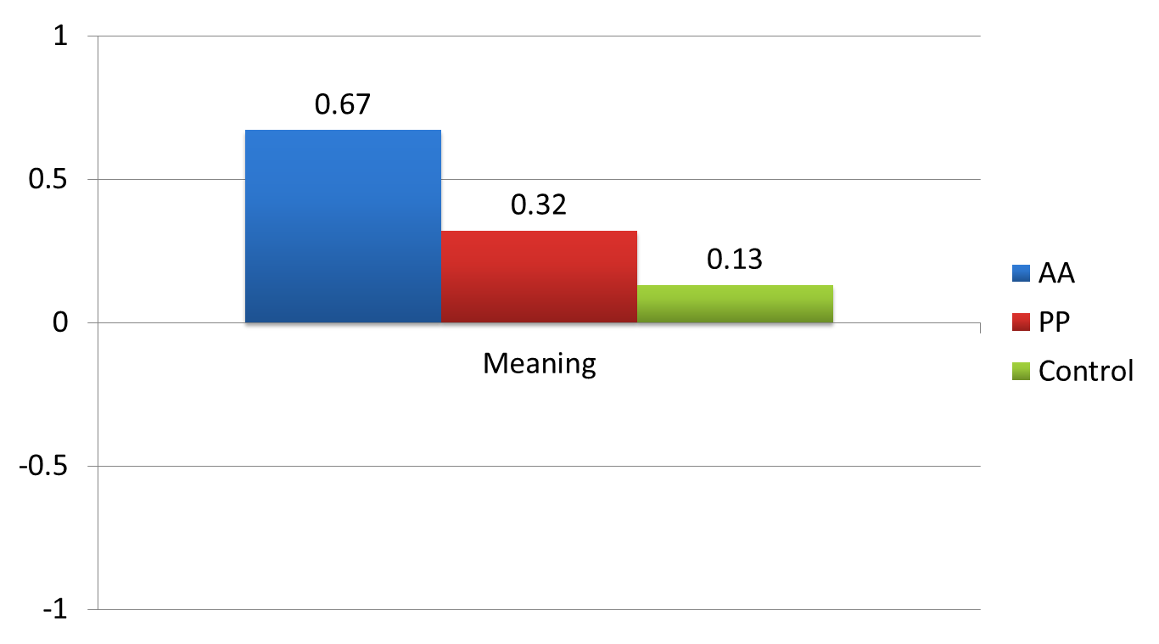
Meaning Means by Condition on a -3 to +3 scale

Slide 14
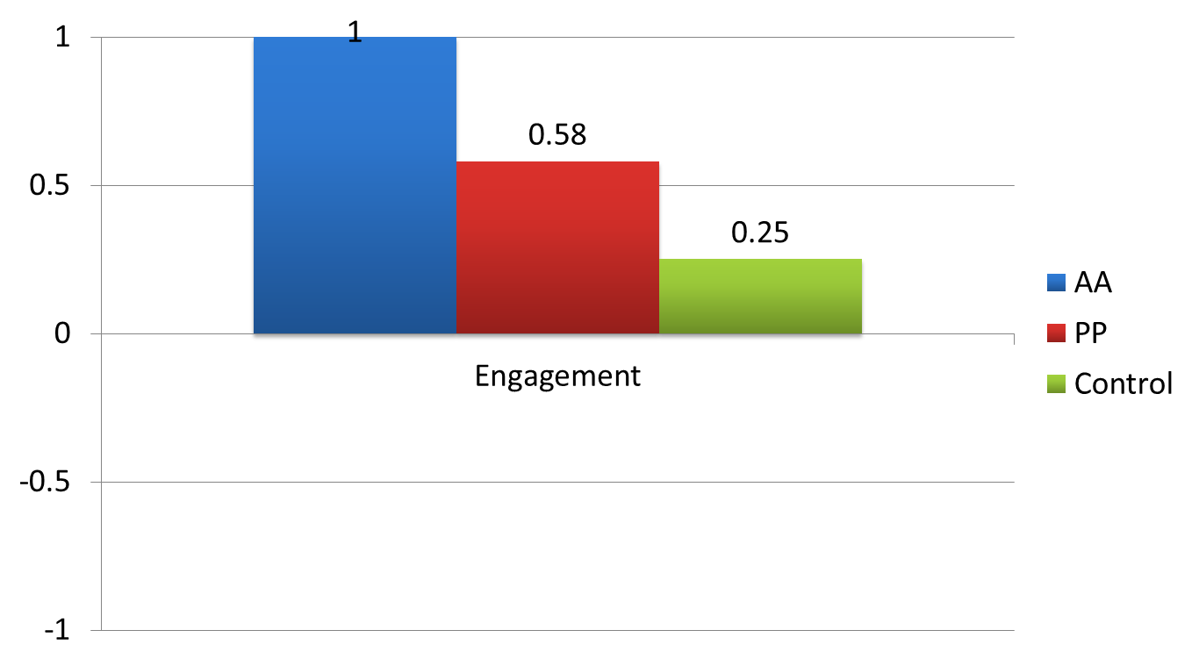
Engagement Means by Condition on a -3 to +3 scale

Slide 15
Six active questions
Did I do my best to:
Be happy?
Find meaning?
Be fully engaged?
Build positive relationships?
Set clear goals?
Make progress toward goal achievement?

Slide 16
Active question research
1710 participants
41 studies
30% reported improvement in all 6 items
59% reported improvement on at least 4
86% reported improvement on at least 1
14% said ‘no change’
Almost no one reported negative change on any item

Slide 17
The two week study
You will get an email every day for two weeks – asking six active questions
You will receive ‘before and after’ questions
The daily process takes just a couple of minutes

Slide 18
Why active questions work
Personal responsibility
Keeping what matters ‘top of mind’
Keep focus on the ‘big picture’

